Slide 1


Causality in Research
DEPH 312 Principles of Scientific Evidence
Talal Alshihayb ^{BDS, DScD}
Diplomate, American Board of Dental Public Health
Assistant Professor
Department of Preventive Dental Science, College of Dentistry, King Saud bin Abdulaziz University for Health Sciences
Department of Health Policy and Health Services Research, Henry M. Goldman School of Dental Medicine, Boston University
December 18, 2023
shihaybt@ksau-hs.edu.sa

Slide 2
Recap
Study tasks
Measures of disease occurrence
Measures of association
Study designs
Validity and precision
Random and systematic errors in research

Slide 3
Errors in research
1
Random (precision)
Affects measures of dispersion (variance/standard deviation/range)
May affect point estimates (prevalence/incidence/effect size e.g., risk difference)
Systematic (validity)
Affects point estimates (prevalence/incidence/effect size e.g., risk difference)
What do we mean by this?
Difference between true causal effect and associational effect estimated from data
Structural reasons
2

Slide 4
Types of systematic errors
Depends on study task (epidemiological paradigm)
Descriptive
Predictive
Causal
Hernán MA, Hsu J, Healy B. A second chance to get causal inference right: a classification of data science tasks. Chance. 2019 Jan 2;32(1):42-9.

Slide 5
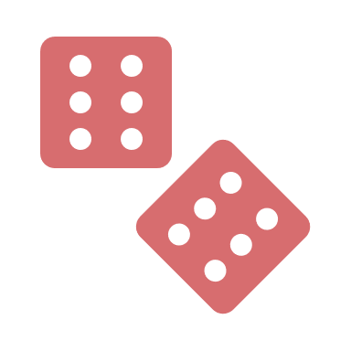








Potential explanations of an association
Systematic errors
1
2
3
4
5
6
Random error
Sharing a common cause
(confounding bias)
Conditioning on a common effect
(selection bias)
Measurement error
(measurement bias)
Reverse causation
Causal

Slide 6
Descriptive studies
Selection bias
Measurement bias
Misclassification bias (categorical)
Information bias
Hernán MA, Hsu J, Healy B. A second chance to get causal inference right: a classification of data science tasks. Chance. 2019 Jan 2;32(1):42-9.

Slide 7
Predictive studies
Selection bias
Measurement bias
Misclassification bias (categorical)
Information bias
Hernán MA, Hsu J, Healy B. A second chance to get causal inference right: a classification of data science tasks. Chance. 2019 Jan 2;32(1):42-9.

Slide 8
Example of a data generating process in social sciences
Risk difference
0
Has effect
Risk difference
0
Has no effect
Notes:
Remember lack of an arrow is a very strong assumption (alcohol does not change lung cancer for anybody in the study)

Slide 9

Beware of risk factor epidemiology
Causal effect of periodontitis on oral cancer=0
Causal effect of smoking on oral cancer=0.5
Causal effect of gender on oral cancer=
(direct + indirect causal effect) =
0.3 + (0.3*0.5) =0.45
Risk difference=0.3
Risk difference=0.3
Risk difference=0.3
Risk difference=0.3
Risk difference=0.5

Slide 10
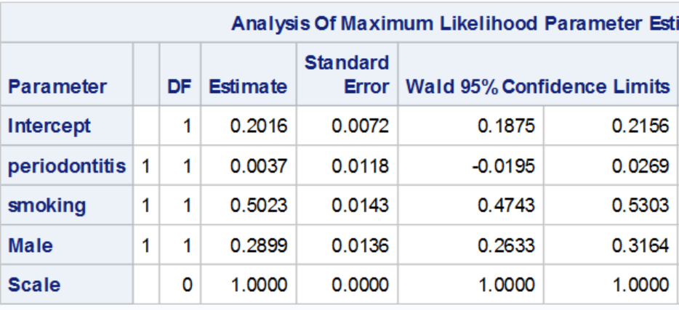
Risk difference=0.3
Risk difference=0.3
Risk difference=0.3
Risk difference=0.3
Risk difference=0.5
Causal effect of periodontitis on oral cancer=0
Causal effect of smoking on oral cancer=0.5
Causal effect of gender on oral cancer=0.45

Slide 11
Just focus on interpreting the effect of the main exposure

Slide 12

LECTURE LEARNING OUTCOMES OF EACH OF THE DIDACTIC SESSIONS
REFERENCE:
Chapter 3 in Rothman KJ. Epidemiology: an introduction. Oxford university press; 2012 May 4
Chapter 3 in Westreich, Daniel. Epidemiology by Design. Oxford University Press. Kindle Edition
Chapter 16 in Oral Epidemiology: A Textbook on Oral Health Conditions, Research Topics and Methods
LECTURE LEARNING OUTCOMES:
Describe the basics of causality in research.
Describe the different types of causal effects.

Slide 13
What is a cause?

Slide 14
Imagine the world without causes

Slide 15
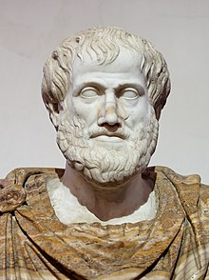
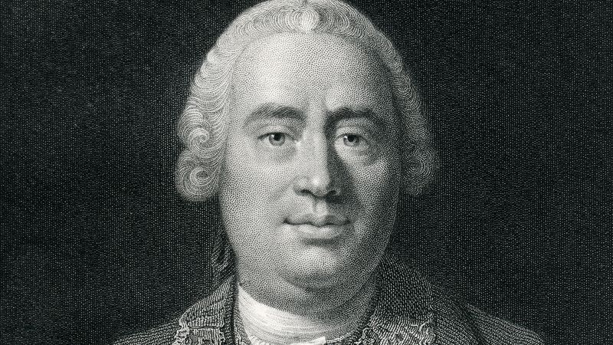
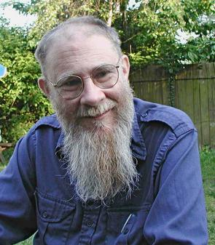
Brief philosophical history of causality
Aristotle
David Hume
David Lewis
https://cdn.britannica.com/72/215372-138-D9D348EF/Top-questions-answers-David-Hume.jpg?w=800&h=450&c=crop
1^{st:} Regularity
2nd: Counterfactuals
https://upload.wikimedia.org/wikipedia/en/a/ad/David-K.-Lewis.jpg
A sculpture by Lysippos
https://en.wikipedia.org/wiki/Aristotle
Parallel universe explanation of Counterfactuals
Material
Formal
Efficient
Final
4 causes

Slide 16
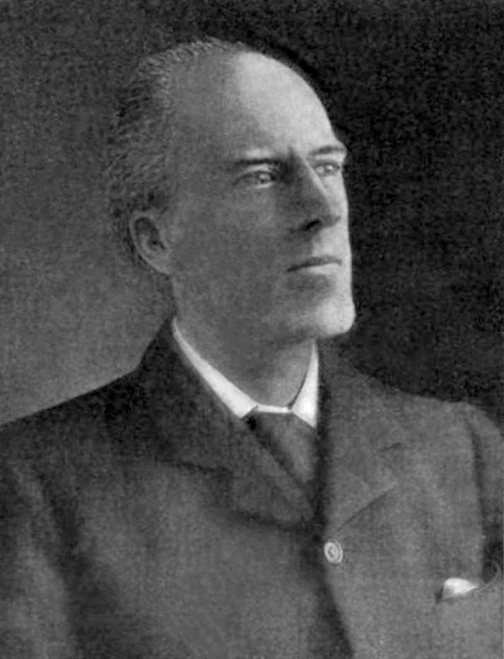
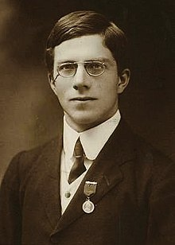

Statistics and causality
Karl Pearson
Ronald Fisher
https://www.google.com/url?sa=i&url=https%3A%2F%2Ftenor.com%2Fsearch%2Fignore-gifs&psig=AOvVaw3Yc8-NyRhmOkRj1iJJFVS6&ust=1638540250309000&source=images&cd=vfe&ved=0CAwQjhxqFwoTCPClz6OkxfQCFQAAAAAdAAAAABAW
https://upload.wikimedia.org/wikipedia/commons/1/18/Karl_Pearson%2C_1912.jpg
https://upload.wikimedia.org/wikipedia/commons/thumb/a/aa/Youngronaldfisher2.JPG/220px-Youngronaldfisher2.JPG

Slide 17
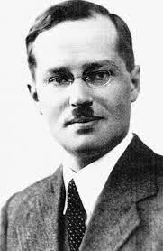
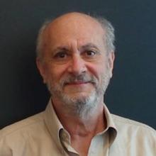
Statistics and causality
Jerzy Neyman
Donald Rubin
Used counterfactuals in Randomized clinical trials (RCTs)
Extended counterfactuals to observational studies
https://statistics.fas.harvard.edu/sites/hwpi.harvard.edu/files/statistics-2/files/rubin_0.jpg?m=1538659977
http://magazine.amstat.org/wp-content/uploads/2017/04/Neyman.jpg

Slide 18
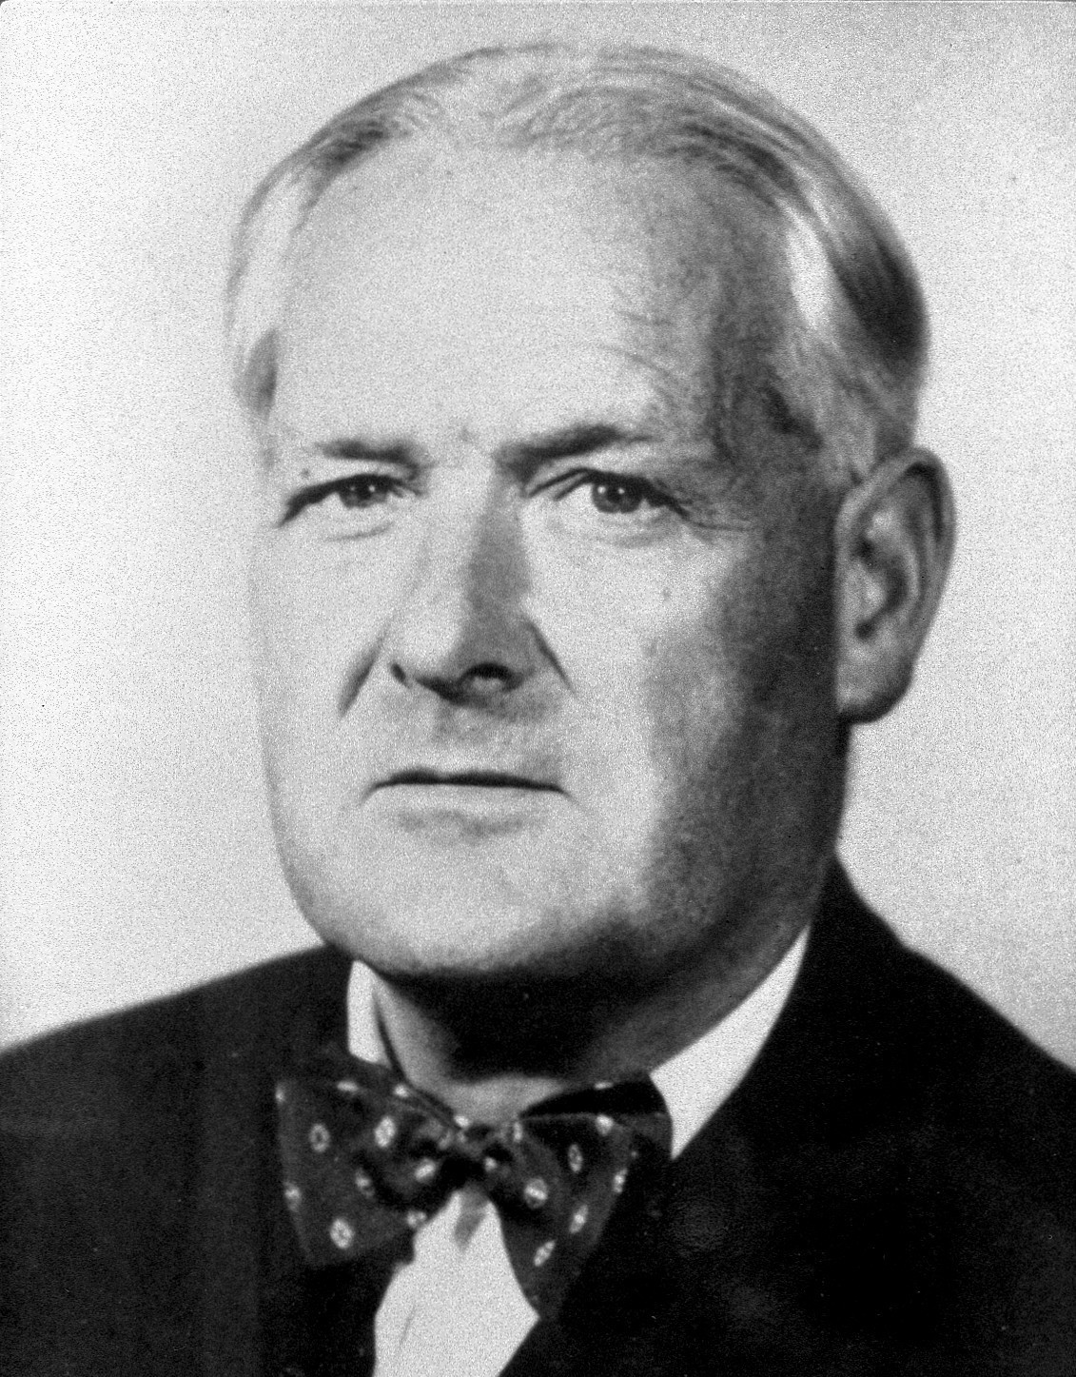
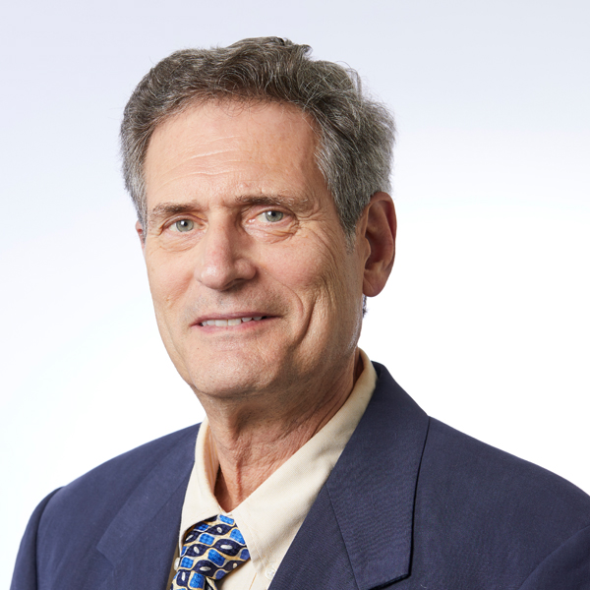
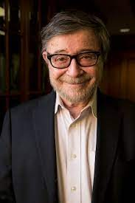
Causality in health research
Bradford Hill
Kenneth Rothman
Judea Pearl
https://upload.wikimedia.org/wikipedia/commons/e/eb/Austin_Bradford_Hill.jpg
https://www.bu.edu/sph/files/2013/10/Kenneth-Rothman-1.jpg
https://www.google.com/url?sa=i&url=http%3A%2F%2Fbayes.cs.ucla.edu%2Fjp_home.html&psig=AOvVaw17zdOKSRPQGJjWLynkbkm7&ust=1670779895085000&source=images&cd=vfe&ved=0CBAQjRxqFwoTCLjfiaPK7_sCFQAAAAAdAAAAABAE
9 criteria for causality
Sufficient component cause (causal pie)
Causal inference

Slide 19
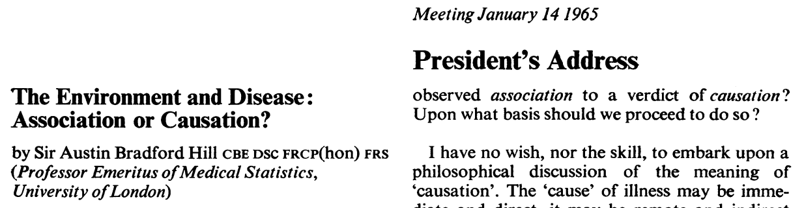
Bradford Hill Criteria
Strength of association
Consistency
Temporality
Biological gradient (dose response)
Specificity
Biological plausibility
Coherence
Experiment
Analogy

Slide 20


Bradford Hill Criteria
Measure of association
e.g., Risk difference
The more evidence of causality
Strength of association
The stronger the measure of association (e.g., risk difference/ratio) the more evidence of causality
Problem with strength of association
We can have weak associations that are causal
We can have strong associations that are not causal
Not necessary

Slide 21

Bradford Hill Criteria
Study 1
Study 2
The more evidence of causality
Risk difference
Risk difference
Consistency
If studies agree on the same conclusion
Problem with consistency
Agreement between studies does not mean it is causal
Disagreement between studies does not mean it is not causal
Not necessary
In case of agreement
Both studies are right
Both studies are wrong
In case of disagreement
One study is right and the other is wrong
Both are wrong

Slide 22
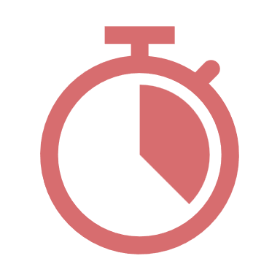
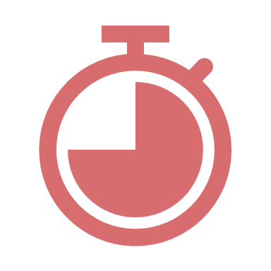
Bradford Hill Criteria
Exposure
Outcome
Exposure needs to happen before the outcome
Then
Temporality
Cause precedes its effect
Exposure needs to happen before the outcome
This is a necessity for establishing a causal relationship

Slide 23


Bradford Hill Criteria
Outcome
The more evidence of causality
Biological gradient (dose response)
The stronger the dose the stronger the effect
Problem with biological gradient
Some causal relations follow a U or inverted U shape (the effect increases with dose up until a certain point where the effect drops)
Not necessary
Dose of exposure
Outcome
Dose of exposure

Slide 24


Bradford Hill Criteria
Affects only
OR
The more evidence of causality
Specificity
There needs to be one effect for each cause (one outcome for an exposure)
There needs to be one cause for each effect (one exposure for an outcome)
Problem with specificity
Some causes have more than one effect and some effect have more than one cause
Not necessary
Only affected by

Slide 25


Bradford Hill Criteria
The more evidence of causality
Exposure
Outcome
Biological plausibility
Explanation of the potential link by a mechanism
Problem with plausibility
It is encouraged but the fact we do not know the mechanism does not mean that it is not causal
Not necessary

Slide 26


Bradford Hill Criteria
The more evidence of causality
Exposure
Outcome
Coherence
The potential relation is in alignment with our understanding of the cause-effect relation (exposure-outcome link)
Problem with coherence
Our current understanding might be wrong
Not necessary

Slide 27

Bradford Hill Criteria
Assess through
The more evidence of causality
Exposure
Outcome
Experiment
Need a randomized clinical trial (RCT)
Problem with experiment
It is encouraged but not required
Not necessary

Slide 28


Bradford Hill Criteria
Exposure 2
Outcome
The more evidence of causality
Based on about
Exposure 1
Outcome
Analogy
Judge an exposure-outcome relation based on other exposure-outcome relations
Problem with analogy
Having no analogy does not mean that the relation is not causal
Not necessary

Slide 29
Bradford Hill Criteria
Viewpoints or perspectives (not criteria or conditions)
“None of my nine viewpoints can bring indisputable evidence for or against the cause-and-effect hypothesis and none can be required as a sine qua non”
Bradford Hill

Slide 30
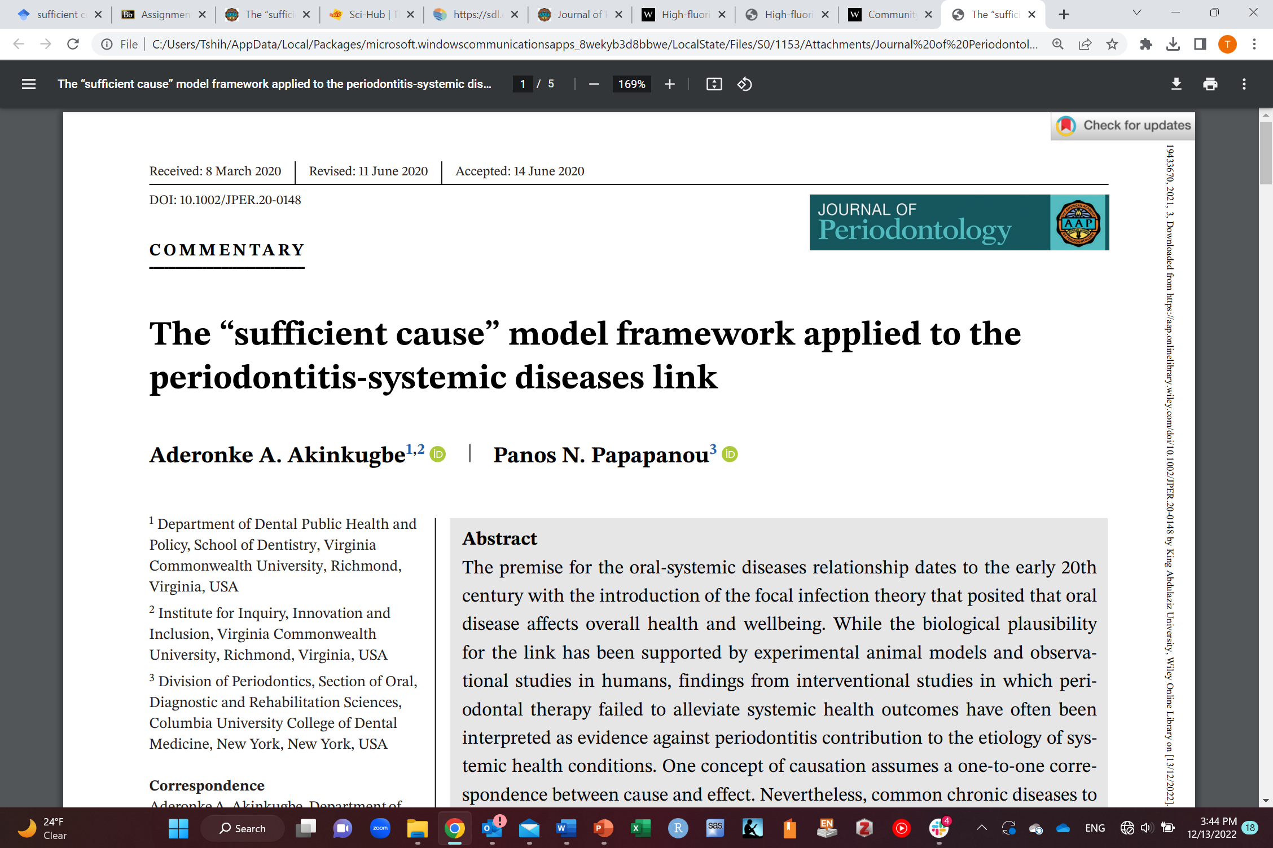
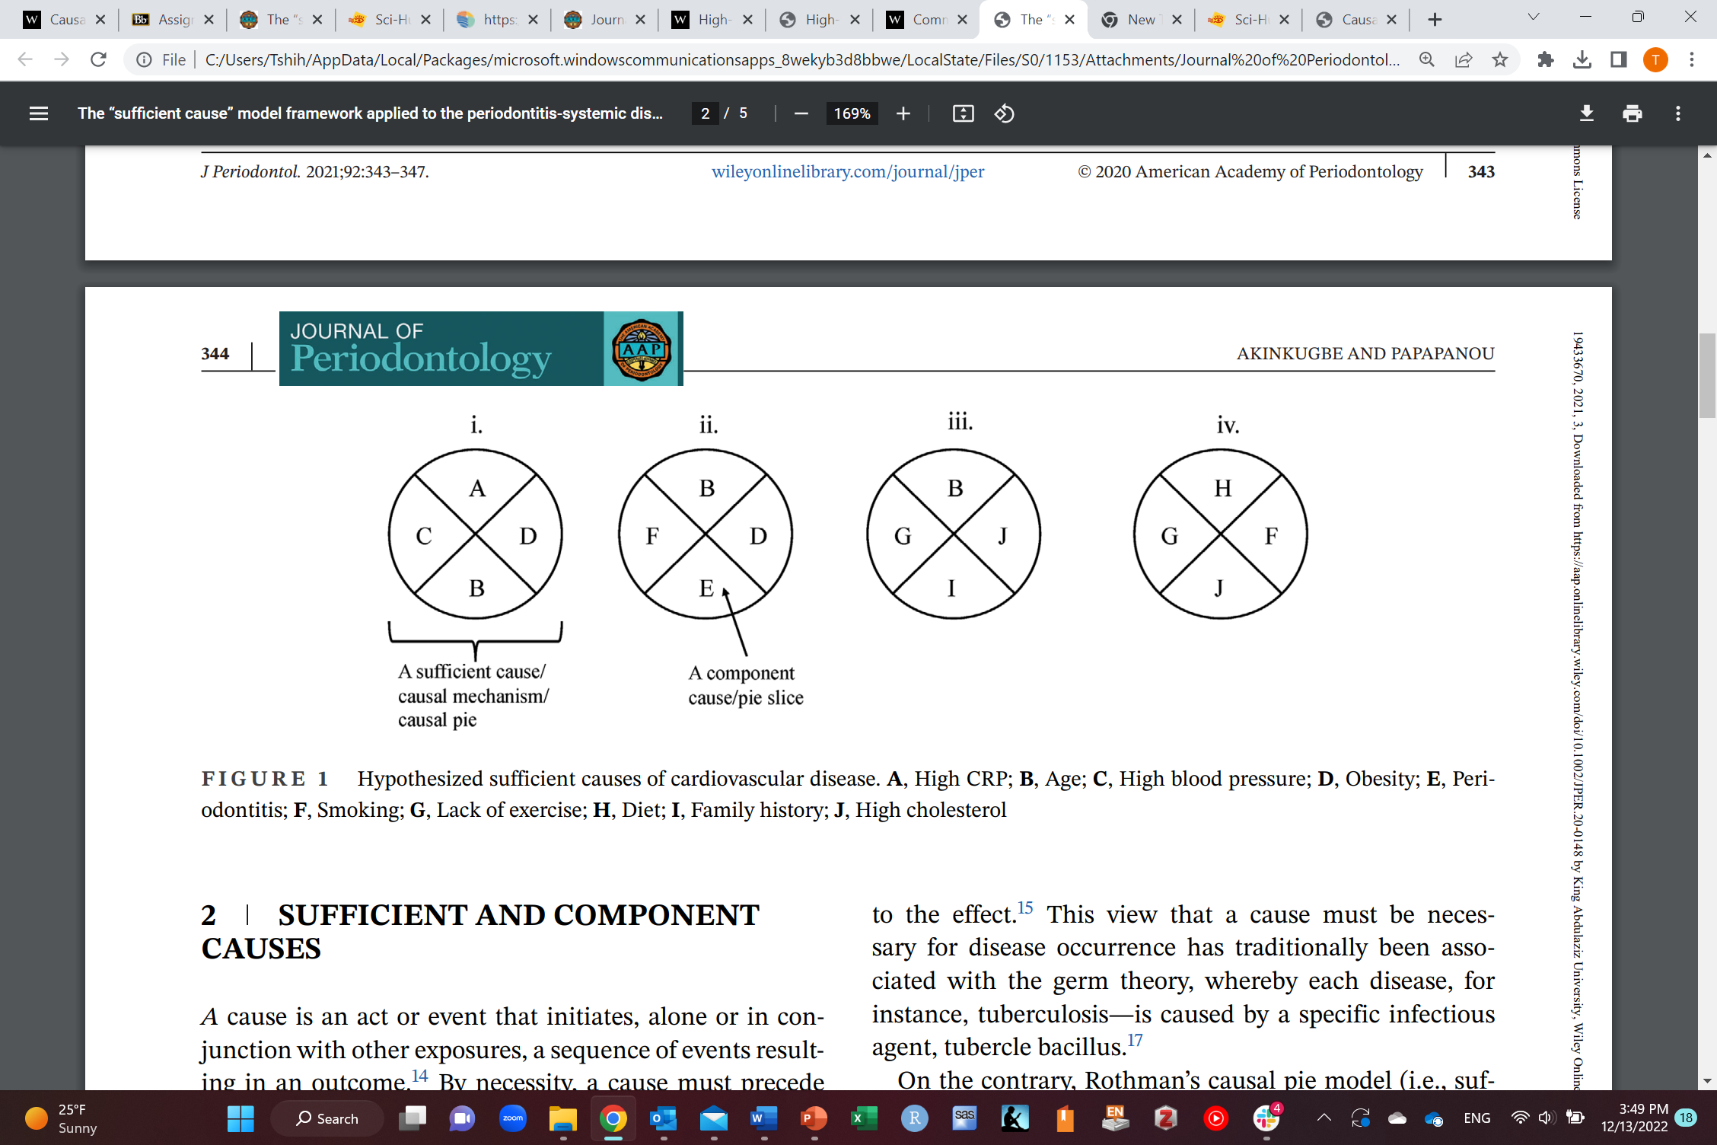
Sufficient component cause (causal pie)

Slide 31
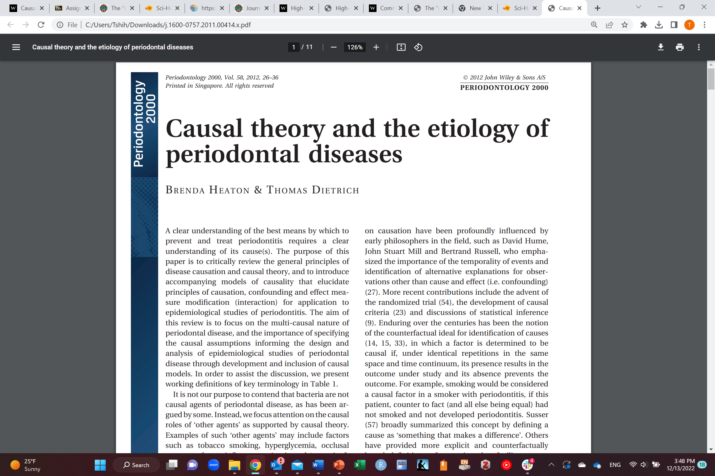
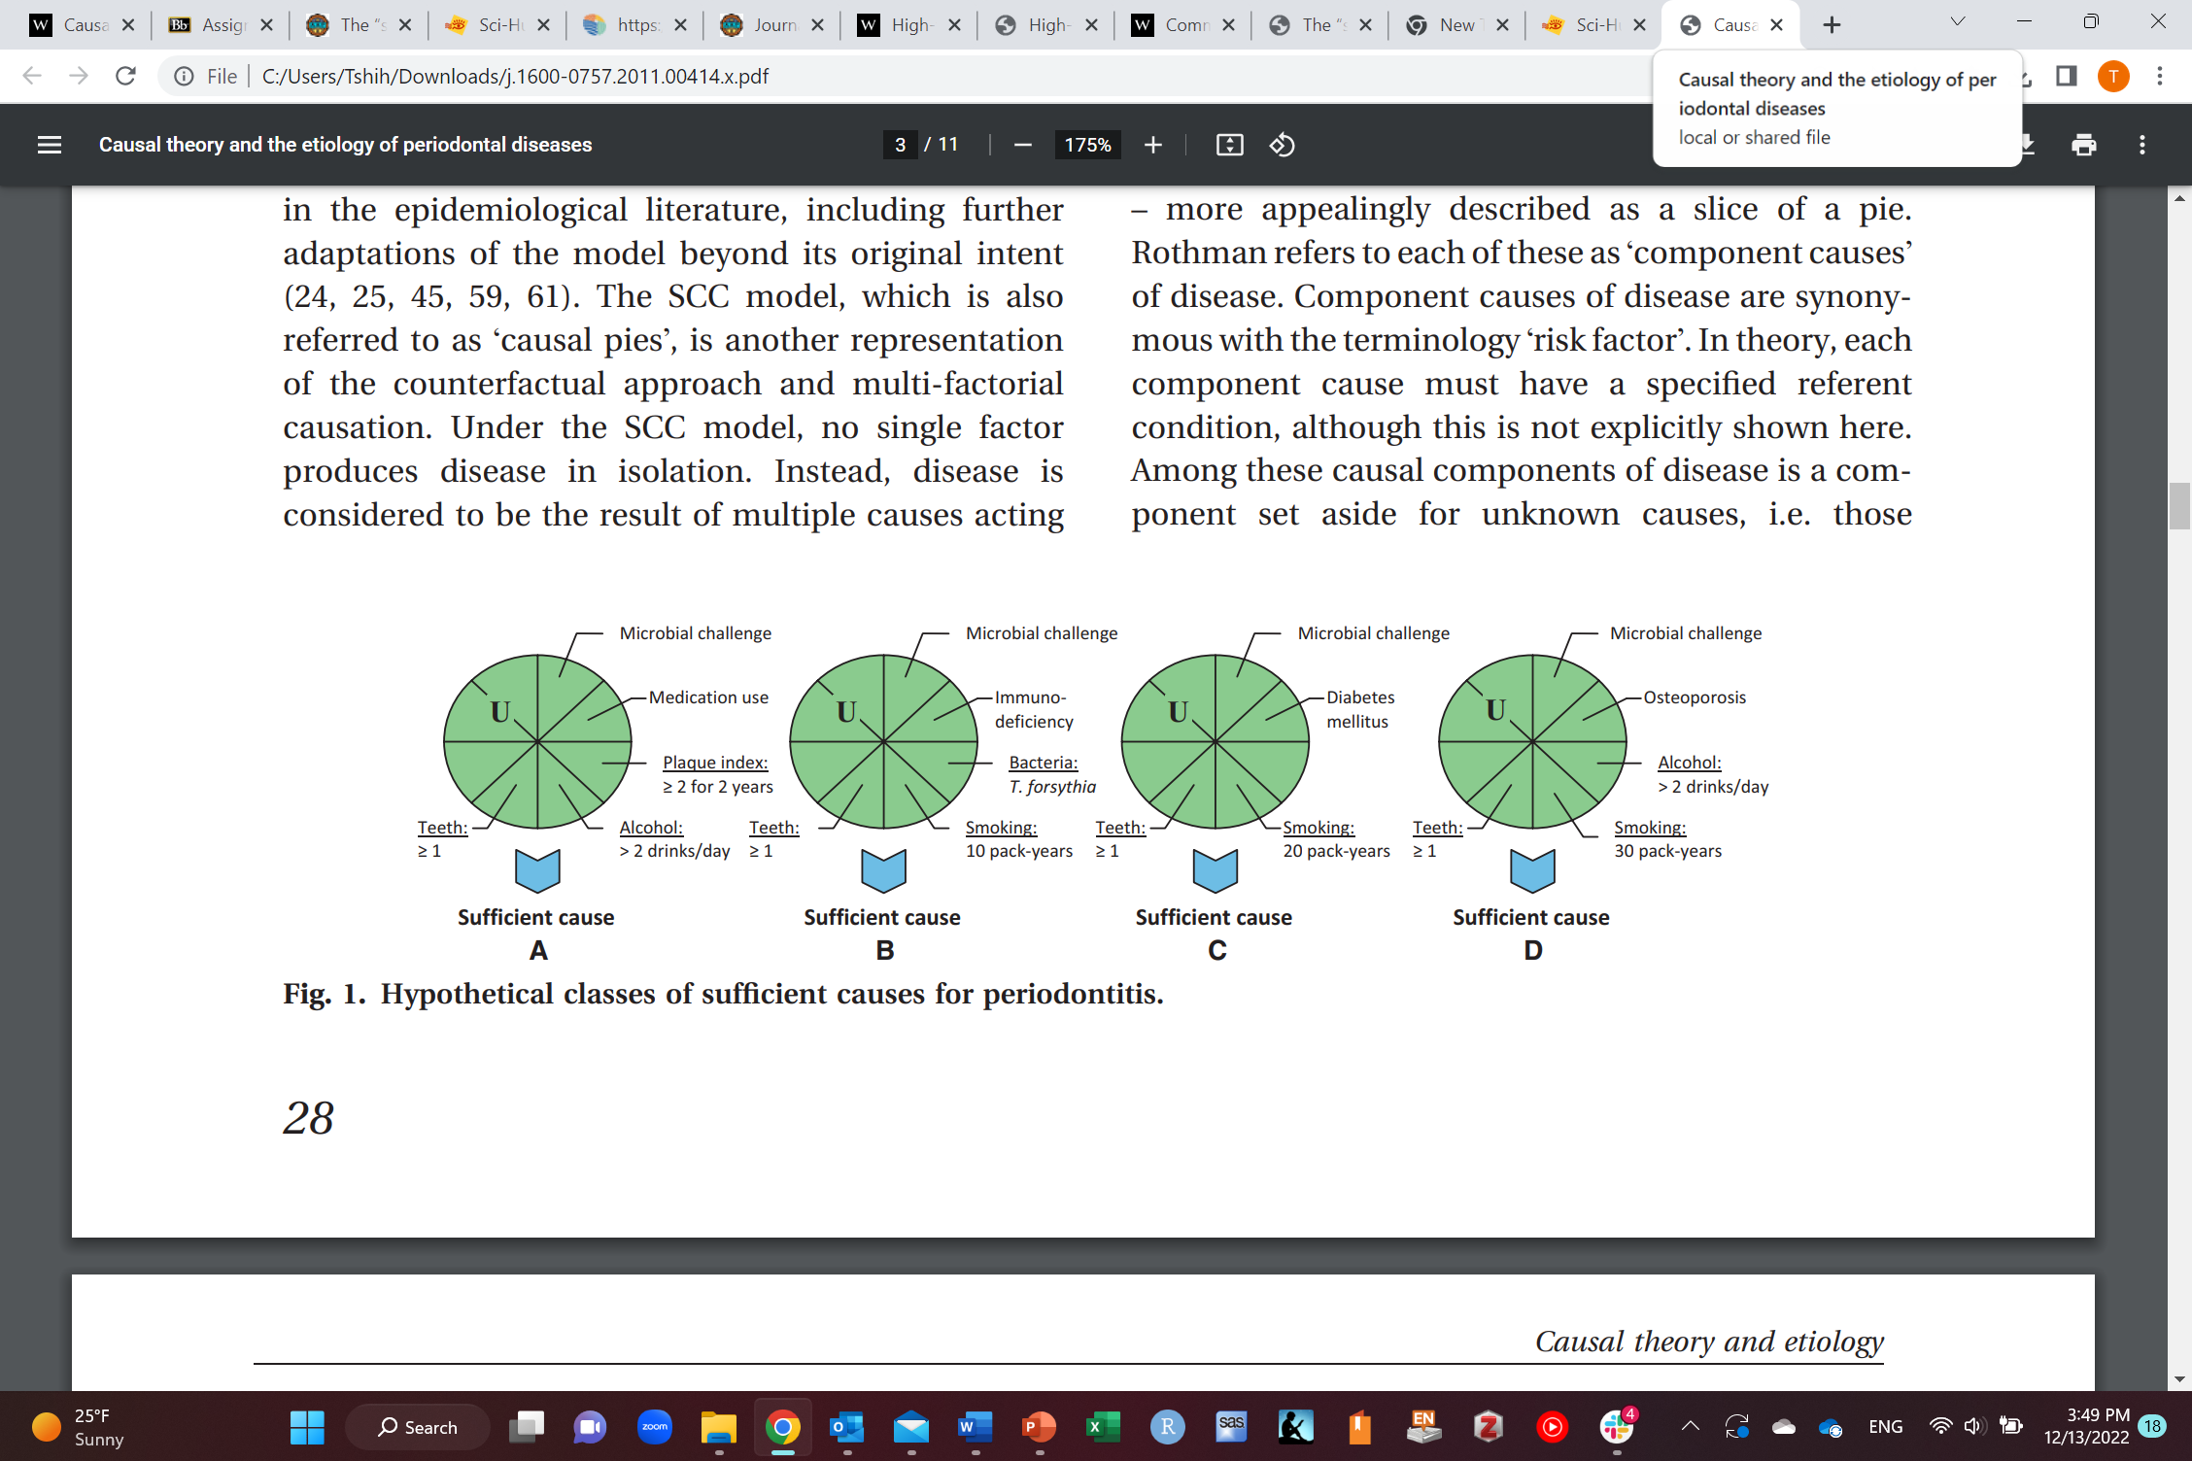
Sufficient component cause (causal pie)

Slide 32


Causal Inference
Time 0
Baseline
Time
Time 0
Baseline
Time
Go back in time

Slide 33
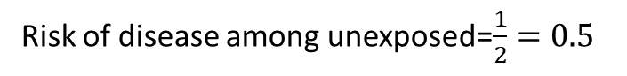
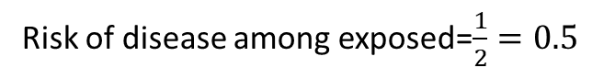
Causal Inference
Person | Hypothetical |  | Hypothetical
Person | Will get disease if receiving drug (1=Yes, 0=No) | Will get disease if not receiving drug (1=Yes, 0=No) | Individual effect (1=Causal, 0=no effect, -1=preventive)
Khalid | 1 | 0 | 1
Ahmad | 0 | 0 | 0
Ruba | 0 | 0 | 0
Shaden | 0 | 1 | -1
Total | 1 | 1 | 0
Actual
Received drug (1=Yes, 0=No) | Received no drug (1=Yes, 0=No) | Got disease if receive drug | Got disease if receive no drug
1 | 0 | 1 | ?
0 | 1 | ? | 0
1 | 0 | 0 | ?
0 | 1 | ? | 1
2 | 2 | 1 | 1
Sum of individual effects=1+0+0+(-1)=0
Risk difference=0.5-0.5=0
Assumptions
 | Diseased | Non-diseased | Total
Exposed | 1 | 1 | 2
Unexposed | 1 | 1 | 2
Total | 2 | 2 | 4
Risk of disease among exposed=$\frac{1}{2}=0.5$
Risk of disease among unexposed=$\frac{1}{2}=0.5$

Slide 34



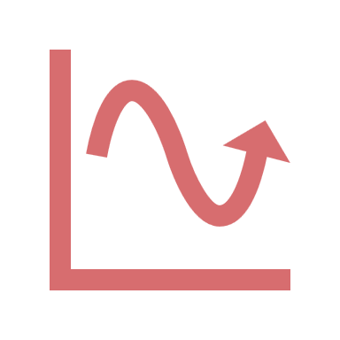
Causal Inference assumptions
No confounding
No selection bias
No measurement error
Everyone has a non-zero chance of receiving either treatment/exposure
Treatment variation irrelevance
Exposure occurs before the outcome
Target population specified
Relation between variables is correctly specified (linear vs. non-linear)

Slide 35
Causal Inference
Average treatment effect (ATE)=average effect if everyone is treated vs. if everyone is not treated
Person | Hypothetical |  | Hypothetical
Person | Will get disease if receiving drug (1=Yes, 0=No) | Will get disease if not receiving drug (1=Yes, 0=No) | Individual effect (1=Causal, 0=no effect, -1=preventive)
Khalid | 1 | 0 | 1
Ahmad | 0 | 0 | 0
Ruba | 0 | 0 | 0
Shaden | 0 | 1 | -1
Total | 1 | 1 | 0
Actual
Received drug (1=Yes, 0=No) | Received no drug (1=Yes, 0=No) | Got disease if receive drug | Got disease if receive no drug
1 | 0 | 1 | ?
0 | 1 | ? | 0
1 | 0 | 0 | ?
0 | 1 | ? | 1
2 | 2 | 1 | 1
Sum of individual effects=1+0+0+(-1)=0
Risk difference=0.5-0.5=0
Assumptions
 | Diseased | Non-diseased | Total
Exposed | 1 | 1 | 2
Unexposed | 1 | 1 | 2
Total | 2 | 2 | 4
Risk of disease among exposed=$\frac{1}{2}=0.5$
Risk of disease among unexposed=$\frac{1}{2}=0.5$

Slide 36
Hypothesis
Null: average height difference between males and females is zero (some males are taller and some are shorter)
Sharp null: height difference between males and females is exactly zero for everybody (all males and females have the same height)
Other: average height difference between males and females is non-zero
average height difference between males and females is positive
average height difference between males and females is negative
average height difference between males and females is exactly 5 cm
average height difference between males and females is at least 5 cm
average height difference between males and females is at most -5 cm
average height difference between males and females is at least |5| cm
Krieger N. Epidemiology and the people's health: theory and context. Oxford University Press; 2011 Mar 23.

Slide 37


“the other half jointly to Joshua D. Angrist and Guido W. Imbens "for their methodological contributions to the analysis of causal relationships."
https://www.nobelprize.org/prizes/economic-sciences/2021/summary/

Slide 38
Beware of risk factor epidemiology
Causal effect of periodontitis on oral cancer=0
Causal effect of smoking on oral cancer=0.5
Causal effect of gender on oral cancer=
(direct + indirect causal effect) =
0.3 + (0.3*0.5) =0.45
Risk difference=0.3
Risk difference=0.3
Risk difference=0.3
Risk difference=0.3
Risk difference=0.5

Slide 39
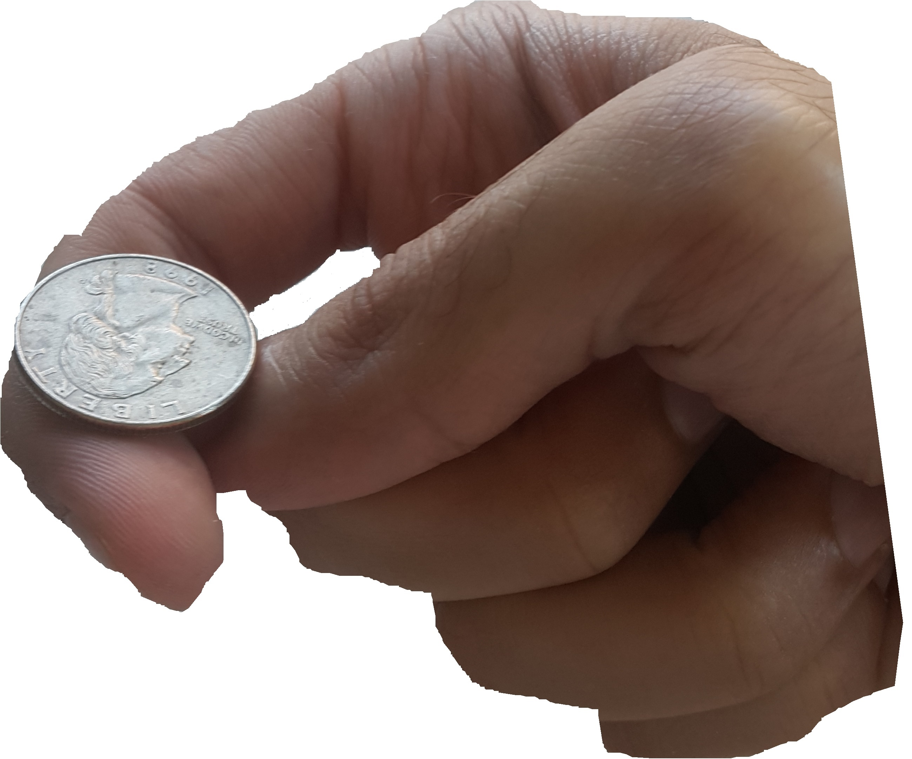
Randomized clinical trials (RCTs)
This means:
100% (everyone) assigned to take the drug actually took the drug
and
0% (no one) assigned to not take drug actually took the drug
(adherence is complete or 100% adherence or compliance)
Risk difference=1
Risk difference=0.2
Causal effect of drug on periodontitis= 0.2
Per-protocol effect
Causal effect of random assignment to drug on periodontitis= 1*0.2 = 0.2
Intention-to-treat effect

Slide 40
Randomized clinical trials (RCTs)
This means:
50% (half) assigned to take the drug actually took the drug
and
0% (no one) assigned to not take drug actually took the drug
(adherence is incomplete or <100% adherence or compliance)
Adherence is random (nothing affects it)
Risk difference=0.5
Risk difference=0.2
Causal effect of drug on periodontitis= 0.2
Per-protocol effect
Causal effect of random assignment to drug on periodontitis= 0.5*0.2 = 0.1
Intention-to-treat effect

Slide 41
Randomized clinical trials (RCTs)
This means:
100% (everyone) assigned to take the drug actually took the drug
and
50% (half) assigned to not take drug actually took the drug
(adherence is incomplete or <100% adherence or compliance)
Adherence is random (nothing affects it)
Risk difference=0.5
Risk difference=0.2
Causal effect of drug on periodontitis= 0.2
Per-protocol effect
Causal effect of random assignment to drug on periodontitis= 0.5*0.2 = 0.1
Intention-to-treat effect

Slide 42
Randomized clinical trials (RCTs)
Intention-to-treat effect
Effect of random assignment
Effect if everyone is assigned to treatment vs. if everyone is assigned to no treatment
Includes everyone assigned to a group in the analysis regardless whether they adhered to assigned treatment or not
Per-protocol effect
Effect of treatment itself
Effect if everyone receives treatment vs. if everyone is receives no treatment
Only includes those who adhered to their assigned group in the analysis (those who followed the protocol)

Slide 43
Randomized clinical trials (RCTs)
This means:
100% (everyone) assigned to take the drug actually took the drug
50% (half) assigned to not take drug actually took the drug
(adherence is incomplete or <100% adherence or compliance)
Adherence is random (nothing affects it)
Risk difference=0.5
Risk difference=0.2
Causal effect of drug on periodontitis= 0.2
Per-protocol effect
Causal effect of random assignment to drug on periodontitis= 0.5*0.2 = 0.1
Intention-to-treat effect

Slide 44
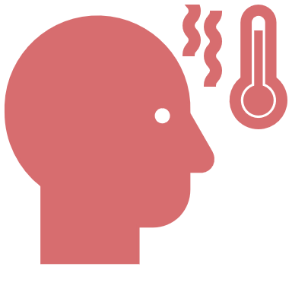
Randomized clinical trials (RCTs)
This means:
90% assigned to take the drug actually took the drug
40% assigned to not take drug actually took the drug
(adherence is incomplete or <100% adherence or compliance)
Risk difference=0.5
This means:
30% who are sick did not adhere to taking the drug
0% who are not sick did not adhere to taking drug
Adherence is not random (affected by being sick)
Risk difference=0.2
Risk difference=-0.3
Risk difference=0.4
Causal effect of drug on periodontitis= 0.2
Per-protocol effect
Causal effect of random assignment to drug on periodontitis= 0.5*0.2 = 0.1
Intention-to-treat effect

Slide 45
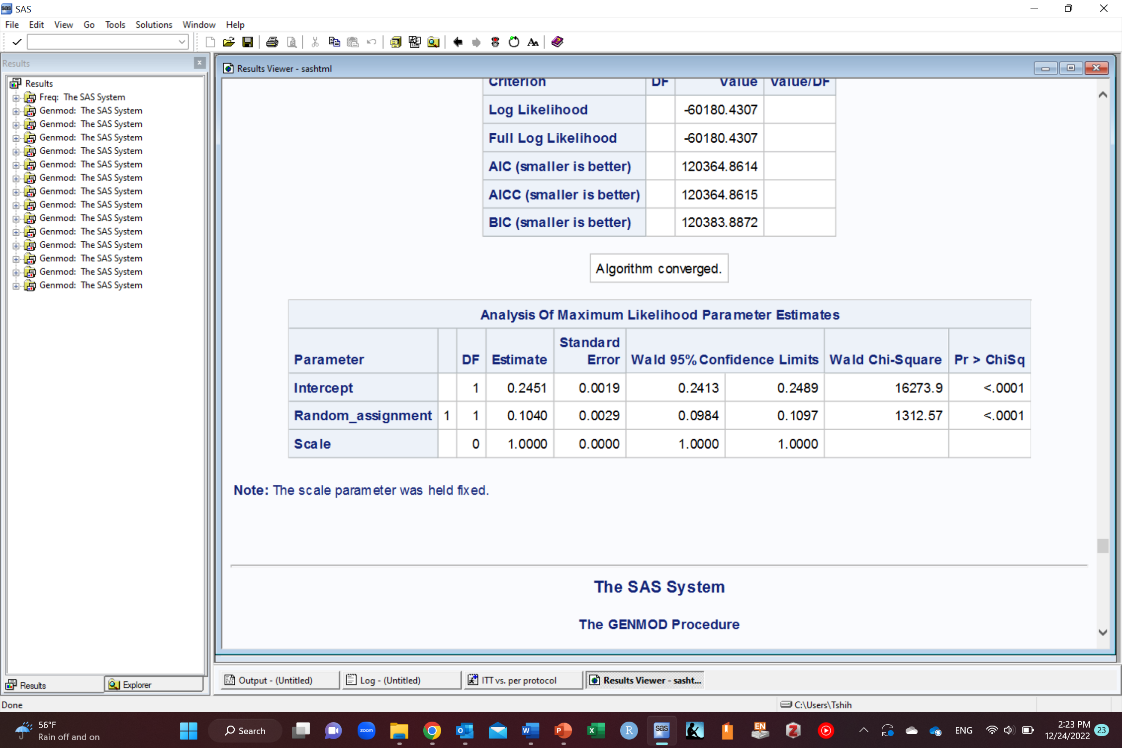
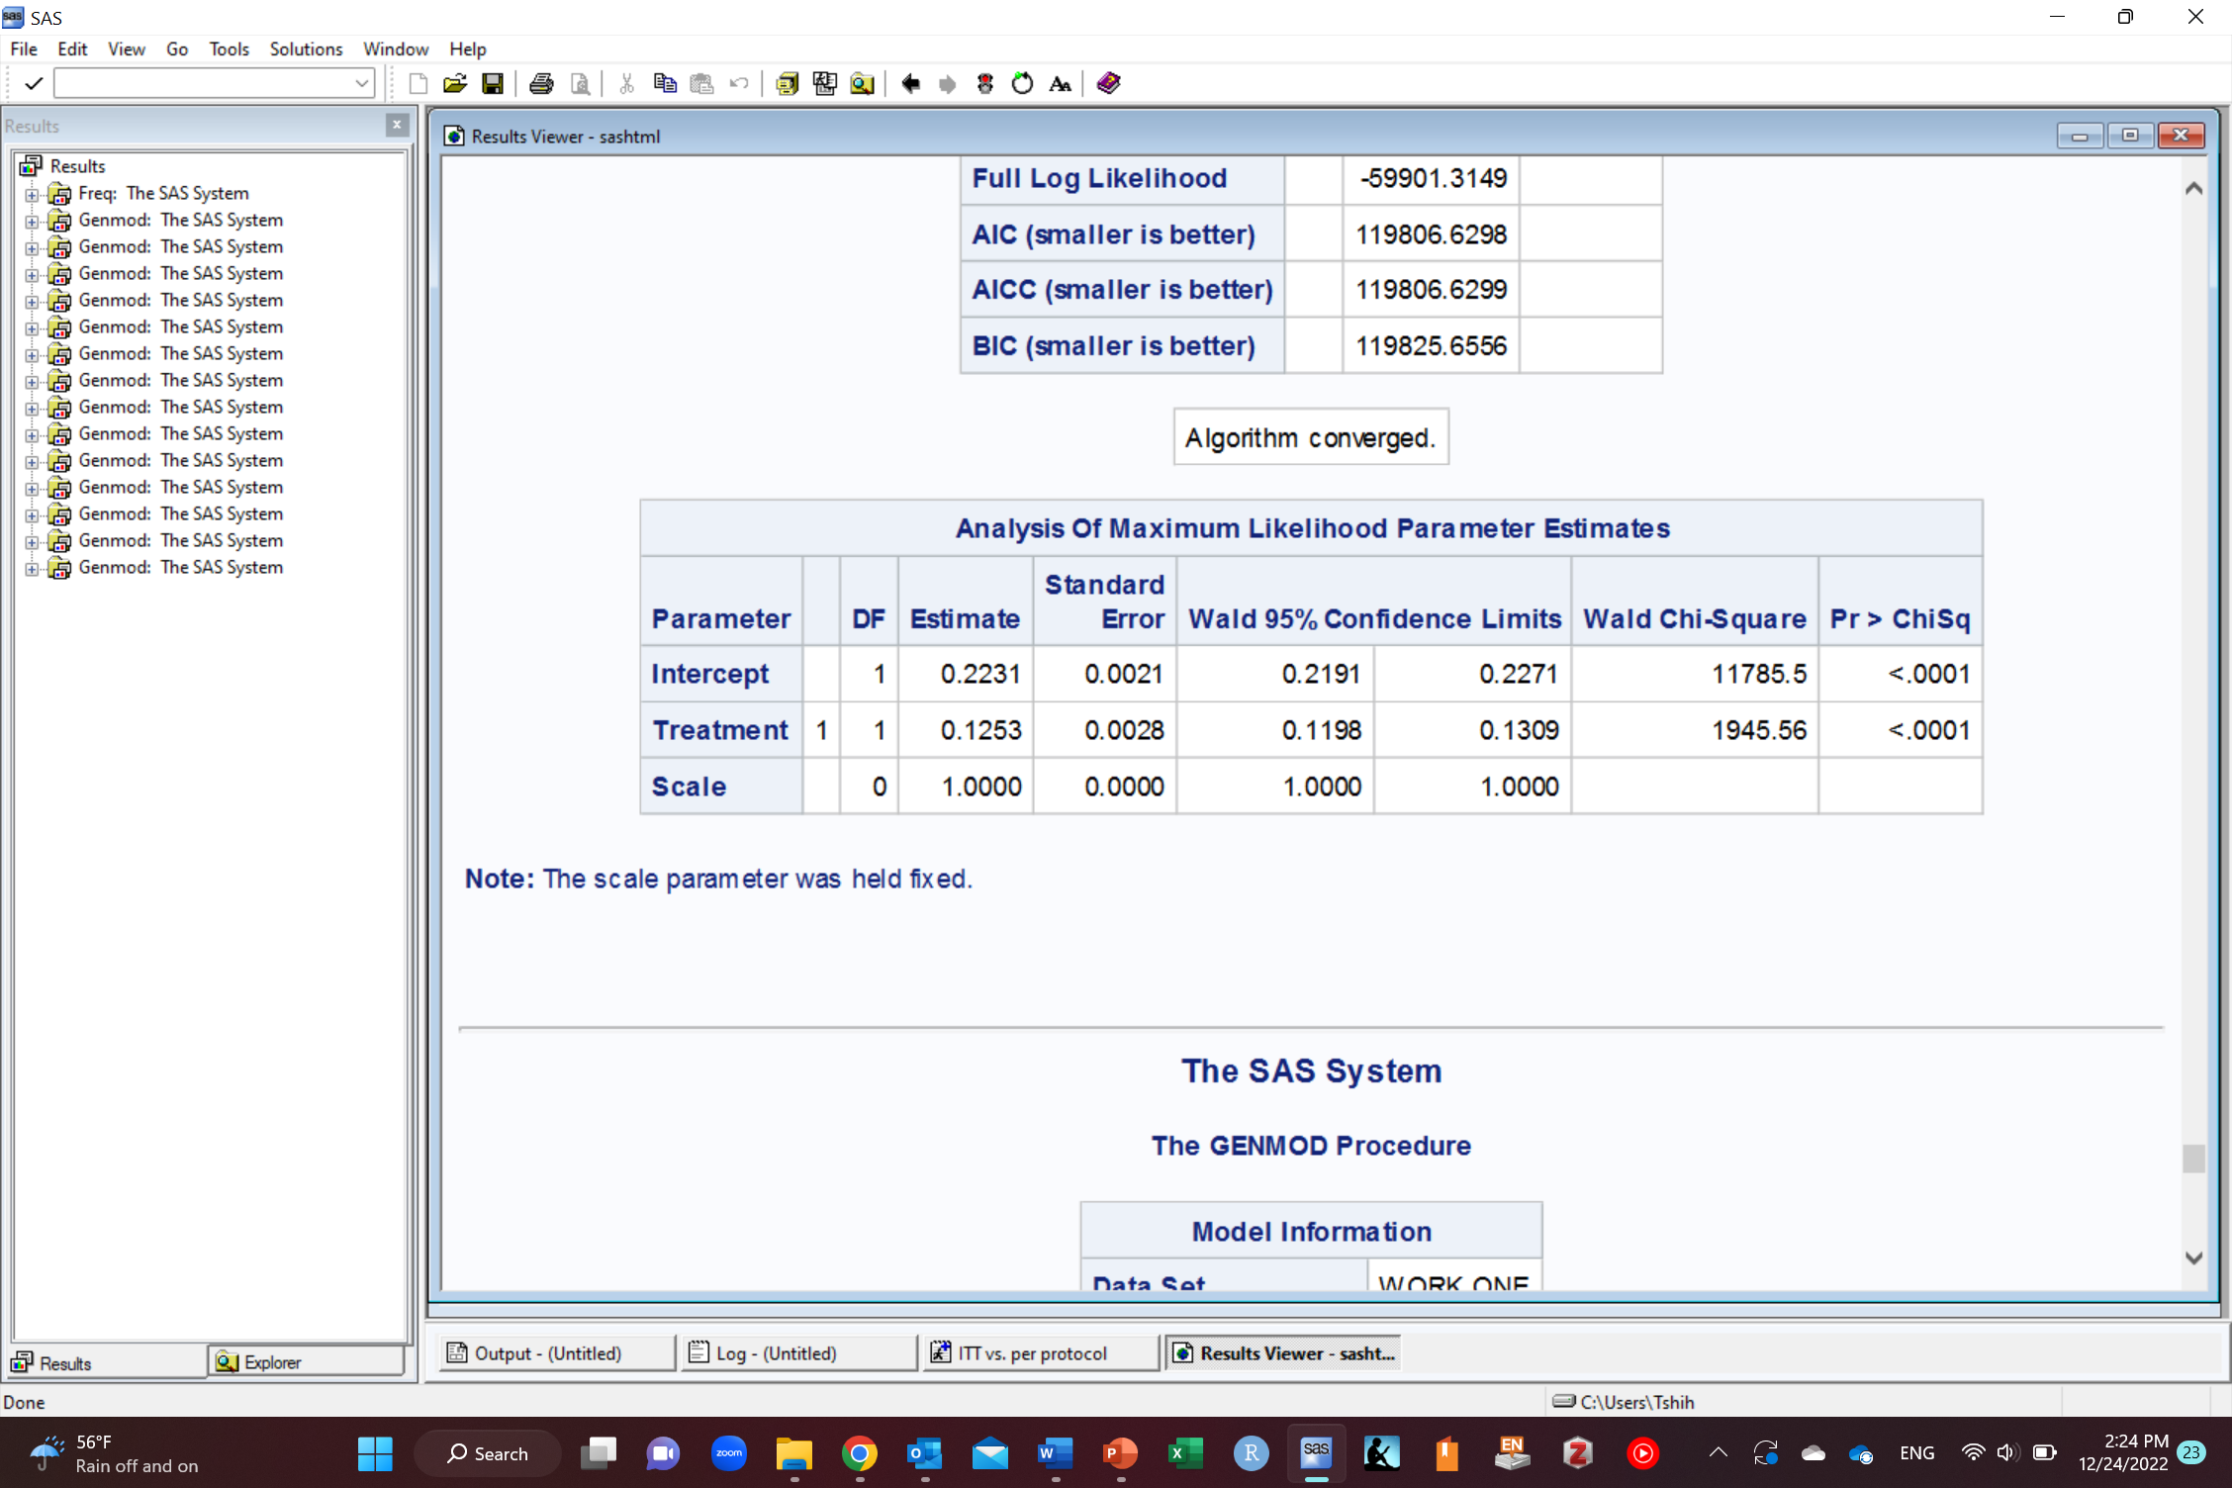
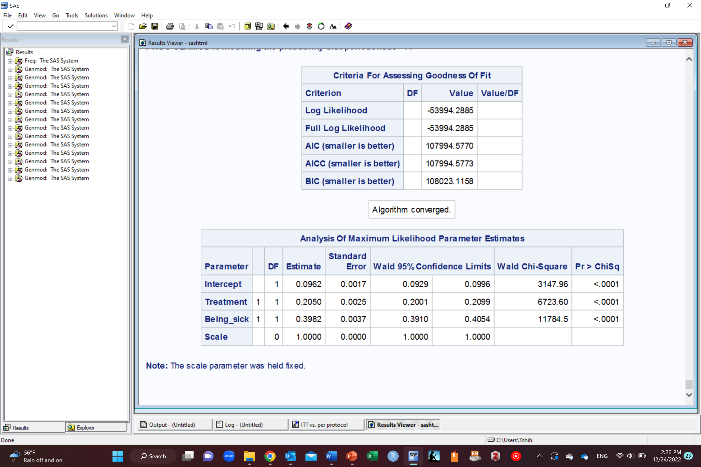
Randomized clinical trials (RCTs)
This means:
90% assigned to take the drug actually took the drug
40% assigned to not take drug actually took the drug
(adherence is incomplete or <100% adherence or compliance)
This means:
30% who are sick did not adhere to taking the drug
0% who are not sick did not adhere to taking drug
Adherence is not random (affected by being sick)
Risk difference=0.5
Risk difference=0.2
Risk difference=-0.3
Risk difference=0.4
Intention-to-treat effect
Crude (unadjusted) per-protocol effect
Adjusted per-protocol effect for being sick

Slide 46
Randomized clinical trials (RCTs) vs. Observational Studies
Randomized clinical trials
Intention-to-treat effect
Per-protocol effect
Observational studies
Only per-protocol effect

Slide 47
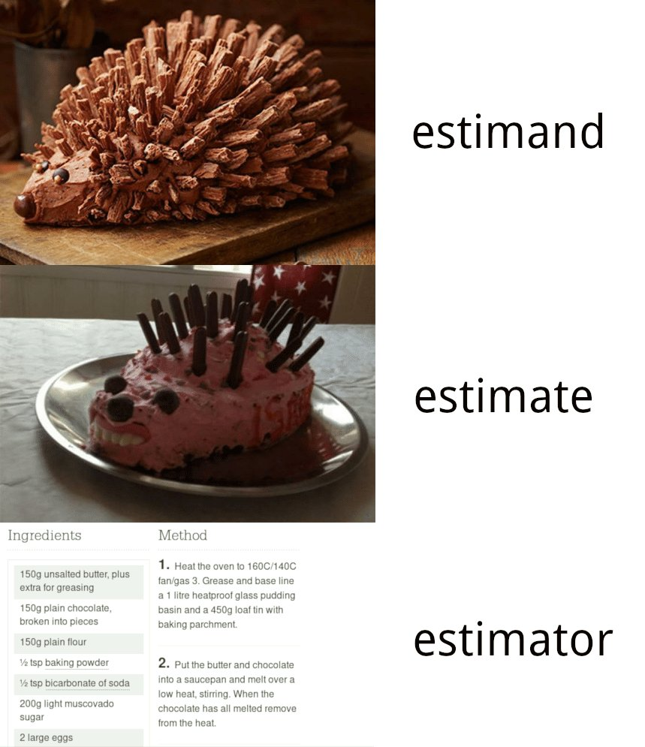
Image credit: @simongrund89

Slide 48
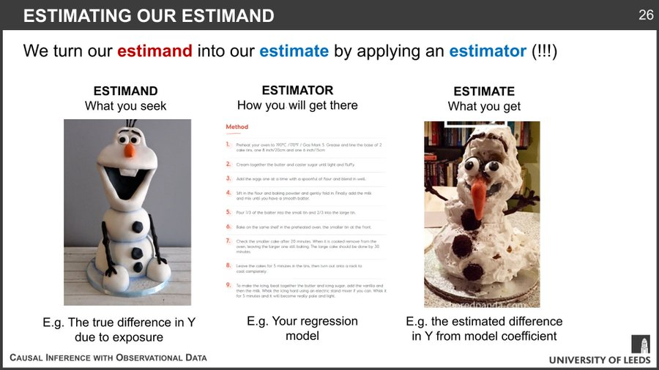
Example by Peter Tennant
https://twitter.com/PWGTennant/status/1164084443742691328

Slide 49
Randomized clinical trials (RCTs)
This means:
90% assigned to take the drug actually took the drug
40% assigned to not take drug actually took the drug
(adherence is incomplete or <100% adherence or compliance)
Risk difference=0.5
This means:
30% who are sick did not adhere to taking the drug
0% who are not sick did not adhere to taking drug
Adherence is not random (affected by being sick)
Risk difference=0.2
Risk difference=-0.3
Risk difference=0.4
Estimands
Causal effect of drug on periodontitis= 0.2
Per-protocol effect
Causal effect of random assignment to drug on periodontitis= 0.5*0.2 = 0.1
Intention-to-treat effect

Slide 50
Randomized clinical trials (RCTs)
This means:
90% assigned to take the drug actually took the drug
40% assigned to not take drug actually took the drug
(adherence is incomplete or <100% adherence or compliance)
This means:
30% who are sick did not adhere to taking the drug
0% who are not sick did not adhere to taking drug
Adherence is not random (affected by being sick)
Risk difference=0.5
Risk difference=0.2
Risk difference=-0.3
Estimators
Risk difference=0.4
Intention-to-treat effect
Crude (unadjusted) per-protocol effect
Adjusted per-protocol effect for being sick

Slide 51
Randomized clinical trials (RCTs)
This means:
90% assigned to take the drug actually took the drug
40% assigned to not take drug actually took the drug
(adherence is incomplete or <100% adherence or compliance)
This means:
30% who are sick did not adhere to taking the drug
0% who are not sick did not adhere to taking drug
Adherence is not random (affected by being sick)
Risk difference=0.5
Risk difference=0.2
Risk difference=-0.3
Estimates
Risk difference=0.4
Intention-to-treat effect
Crude (unadjusted) per-protocol effect
Adjusted per-protocol effect for being sick

Slide 52
Any Questions?
shihaybt@ksau-hs.edu.sa

